Slide 1
Equals Curriculum 2023
Open evening Monday 2nd October 2023

Slide 2
Staff in Equals
Sarah Anderson Garrett – Equals Lead & Equals KS3 Form Teacher
Harriet Sugden – Equals KS4 Form Teacher & English SEND Specialist

Slide 3
Nurture background
Since summer 2022, we have been building on the principles of the Equals curriculum, (Peter Imray) a Semi-Formal Curriculum.
The semi-formal curriculum aims to be an explorative, learning experience, which provides pupils with a broad, balanced, rich and meaningful curriculum.
The Equals pathway is a flexible curriculum approach for students, with a range of learning profiles.
KS4 students have had the opportunity to trial BTEC Pre Vocational Studies 6 lessons a week last academic year.
Learning opportunities reflect the individuals’ needs and aim to develop skills that are purposeful and beneficial to all pupils.
The Equals curriculum aims to prepare learners for life in the wider community, by providing functional and personalised learning, that enables pupils to successfully navigate life in the wider world.

Slide 4
Selection process
When admissions paperwork comes in the SLT admissions panel looks at the individual needs on the EHCP and other reports.
If the EHCP discusses issues such as (but not limited to):
additional support needed within a special school
The need for smaller groups with high staff: pupil ratio
sensory needs including daily plan from OT or the need for a multi-sensory curriculum
communication needs that need daily input
More complex learning difficulties
Students are placed initially within the Equals provision. This does not necessarily mean that this is where they will stay for the entirety of their education at Manor Academy.
Students' primary school will also be consulted in necessary and the students visited within their current provision before a placement is offered.

Slide 5
Where we are now in our development
Restructured the Equals Department from an Equals ASC class and a Nurture Mainbody class to KS3 Equals and KS4 Equals classes (ASC/Mainbody Departments) to enable a more pupil-centred teaching approach.
Two Equals Forms KS3 & KS4 Form Tutor and Teaching Assistants.
Timetabled lessons would be evenly split, enabling Mrs Anderson Garrett and Ms Sugden to teach within both KS3/4 delivering lessons according to their specialisms.
KS3 follow Equals Semi-Formal and Formal Curriculum and KS4 using this as a building block for working towards BTEC Vocational Qualifications facilitating clear progression into the Equals Curriculum Framework.
Minimum of 2 teaching assistants across the 2 classes with the flexibility to move as required to meet needs of the students.
Renamed the Nurture Groups – Equals KS3/KS4 from September 2023

Slide 6
Rationale for Restructure of Equals Department
Supports the whole school as able to use the ASC as a support base whilst also giving students the opportunities to access the whole school, to broaden their experience in school and the wider school community.
Pupils are benefitting from a more pupil-centred curriculum; allowing the content of lessons to be more specific to their individual learning needs and interests.
Parents have clearly expressed that they don’t feel such a broad age range is beneficial, both academically and socially for their child.
KS4 Curriculum is enabling pupils to be given the opportunity to gain more qualifications in Years 10/11, not possible with the pre September 2023 curriculum.

Slide 7
Rationale Restructure of Equals Department continued…
Enables a clear progression for a KS3 pathway (3 years), leading to progression into the KS4 pathway(2 years), preparing students for transition into to KS5.
Two year 7 pupils (minimum) to join each academic year, enabling students to have a ‘buddy’ in their year group.
Enable students to access KS3/KS4 whole school events with their Equals Form where appropriate.
Manor Academy cohort has a mixed and diverse range of pupils with varied academic and social needs. Pupils have a wide range of learning profiles including pupils with; ASC, Moderate Learning Difficulties, ADHD, SEMH, Visual/Hearing impairments and disabilities across the whole school.

Slide 8
Timetabling
Mrs Anderson Garrett teaches Mathematics, Ms Sugden teaches English across both KS3/ KS4.
Equals Curriculum lessons taught 50/50 between both Equals Teachers.
Art, Performing Arts, Food Technology, Woodwork and PE taught by subject specialist teachers in school.
Students who have hybrid timetables will continue and timetables can be flexible in approach according to pupils' individual needs.

Slide 9
English and Mathematics
3 English & 3 Maths (KS3) 4 English & 4 Maths (KS4) lessons a week as standalone subject specific lessons – Decision based on teachers' evaluation and parent feedback.
English and Maths Functional Skills that facilitate students becoming independent adults, is embedded into the Equals Curriculum, in a non-subject specific approach. Teaching & developing skills with a wide range of activities, to promote independence.
Mathematics; We teach the four operations + - / x in a variety of practical and more formal methods. We use practical resources such as base 10, numicon, number lines and Cuisenaire rods to give pupils the best opportunities to succeed and ensure concrete understanding. Pupils engage in all aspects of the Maths curriculum which includes, Number and the Number System, Shape Space and Measure and Data Handling.
English; Reading for Meaning & phonics (Read, Write, Inc.) , Colourful Semantics, Descriptive/Non-Fiction Writing, Writing for Purpose, Story Sequencing, Speech and Language, Spelling, Punctuation and Grammar (SPAG) and Handwriting. KS4 working towards the Ascentis Entry Level 1 Accreditation.

Slide 10
Equals Curriculum Structure
The Equals Curriculum is delivered through a series of linked learning opportunities. These provide a holistic, integrated and multisensory teaching method, that ensures overlearning. Promoting the curriculum’s key principles, through interconnected learning objectives. Learning objectives and outcomes are connected and reinforced, through a common theme identified on KS3 and KS4 Curriculum Overviews for the academic year.
This facilitates pupils, making real life connections, engaging, enriching learning and learning outcomes.
The curriculum supports the generalisation of transferable skills and knowledge to different contexts and real-life situations.
Equals Curriculum includes; Science, History, Religious Education, Geography, PSHE and Independence Skills.

Slide 11
Equals Lessons KS3 example
Local Area
Range of activities:
ICT & Maths - Use of Beebots to navigate, practising directions, programming routes.
Humanities - Linked to people in history e.g., pirates and places of worship in the local area.
English and Maths -Practice following directions from others or from electronic devices such as google maps, planning and following a route around the school & local area, using range of directions including use of a compass.
PSD - Roleplay real life situations; getting lost, finding help, contacting emergency services, going shopping, discovering and accessing local services.
Science – Mini beasts, what classifies a mini-beast? Finding mini beasts, classifying and identifying different mini-beasts.

Slide 12
Equals Lessons KS4 example
Following Equals Semi Formal and Formal Curriculum working towards BTEC Pre Vocational Qualifications
Completing a range of independence activities including:
Travel Training including Road Safety and using public transport
Planning, budgeting and making simple meals
Cleaning and running a home, paying bills, budgeting
Preparing for an occasion
Gardening
Preparation for employment
Personal Care and Puberty and Relationships

Slide 13
Curriculum Maps
There are two documents that show what students will be covering throughout the academic year at KS3 and KS4, the links to the Equals Curriculum and the area of content to enable discussions and reinforcement of learning at home. The areas of content are fluid and led by students engagement.

Slide 14
Curriculum Map

Slide 15
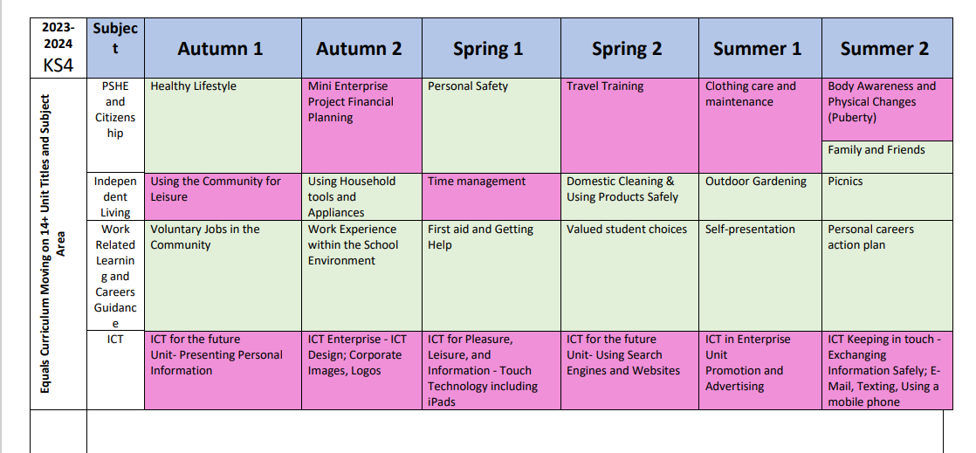
Curriculum Map

Slide 16
KS4 Qualifications
Students will have the opportunity to work towards the following qualifications
Offered to all pupils in school
Ascentis Entry Level 1 + stepping stones to Functional Skills English and Mathematics qualification
Arts Award
OCR Entry Level PE
Duke of Edinburgh Bronze
ASDAN Transition Challenge Independence qualification

Slide 17
KS4 Qualifications
Students will have the opportunity to work towards the following qualifications
Similar to whole school but specific to Equals
Equals 14+ Moving On Qualification – This is specifically in the Equals lessons.
Pearson BTEC Entry Level One - Two in Pre-Vocational Study – This will be taught across the school for students accessing the equals 14+ curriculum in specialist subjects as well as in Equals lessons.
The first cohort of students to achieve all of these qualifications will be those leaving in summer 2025, summer 2024 learners will be working towards these but may not achieve all due to guided learning hours.
These qualifications may not be suitable for all students, and this will be discussed individually at the end of KS3 in preparation for KS4.

Slide 18
Homework
Homework will be set for students each week. (At parents' request)
This will be one piece of English, Mathematics or ‘Equals’ activity per week.
This term we have started using MyMaths and MyLexia for setting work as well as supporting activities.
Feedback is given to students individually, when homework is returned.
It is not compulsory to complete, but we would encourage students to have a go to compliment their learning in school. Students also get ‘above and beyond’ points for completing.

Slide 19
KS3 Sample Timetable
.

Slide 20
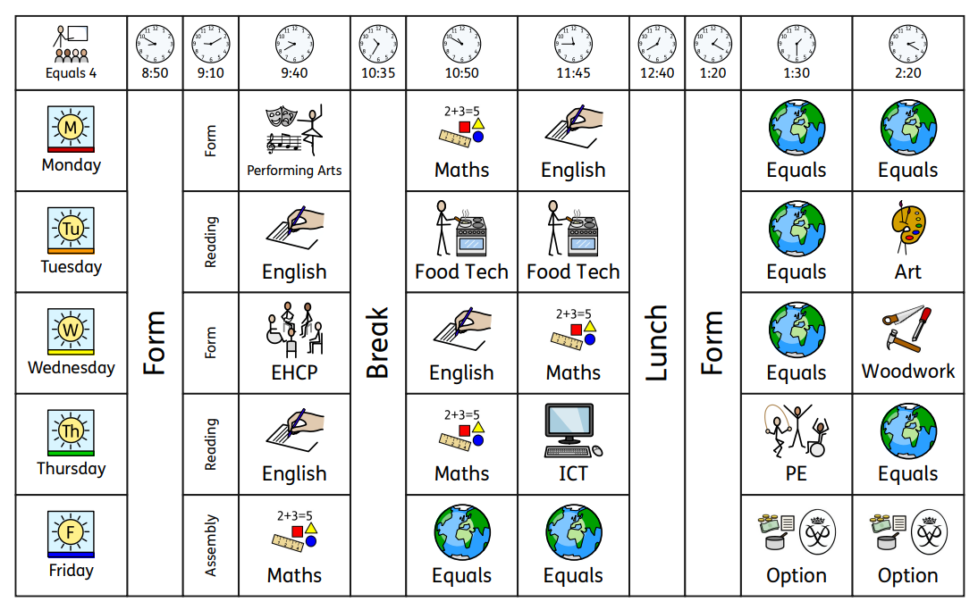
KS4 Sample Timetable

Slide 21
Social Time
KS3 students to use small yard in the ASC and KS4 if appropriate will access the larger yard in the mainbody.
KS3 will have their lunch 12.40-1pm and outside after.
KS4 will have time outside first and then lunch 1-1.20pm.
In line with the whole school, enabling students to spend time with their peer group, as well as Equals cohort.

Slide 22
Trips and Extra Curricular Activities
Whilst Equals has a wide range of Equals specific trips to enhance students’ learning experiences, students will also be given opportunities to join with the whole school for trips and activities in school e.g., the annual school Performing Arts production.

Slide 23
Feedback
Thank you for taking the time to read/listen to this presentation.
If anyone would like to discuss in more detail, please contact Mrs Anderson Garrett to arrange a meeting/telephone call.
Email: sgarrett@manoracademysale.org

Slide 24
Links
SOW samples, curriculum Maps and other relevant information

